Slide 1


Fatwa Chatbot
Lubna Alhenaki

Slide 2
Outline
01
Introduction
02
Methodology Design
03
Demo
04
Conclusion and Future Work

Slide 3
Problem Statement
Little Arabic application special for fatwa
A lot of questions in different aspect specially in high seasons such as Ramdan and AlHajj

Slide 4
Solution?
ChatBot

Slide 5
What Is A Chatbot ?
Chatbot is a computer program that simulates human conversation, or chat, through artificial intelligence.
Chatbot will communicate with a real person.

Slide 6
How Can ChatBot Help?
Accessible Anytime
Easy Communication
Cost Effective
Work Automation

Slide 7
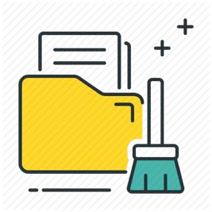
Fatwa Chatbot Methodology Design
Collecting Dataset
Dataset Cleaning
Building Chatbot

Slide 8
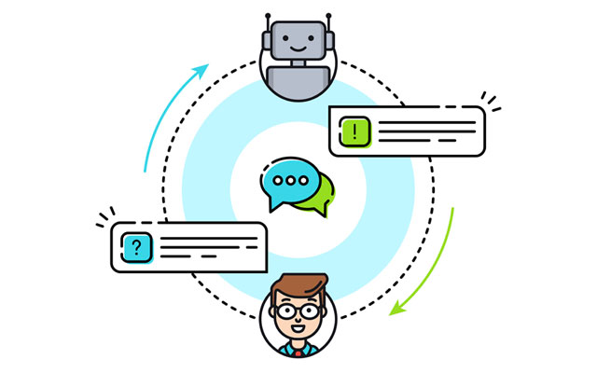
Fatwa Chatbot Collecting Dataset
Dataset Name:
IslamWeb.Net
Target Audience:
Adults
Strategy of Collected the Dataset: Web Scraping using Beautifulsoup
Type of Fatwa:
Different kind of fatwa such as foods, Hajj, and prayer

Slide 9
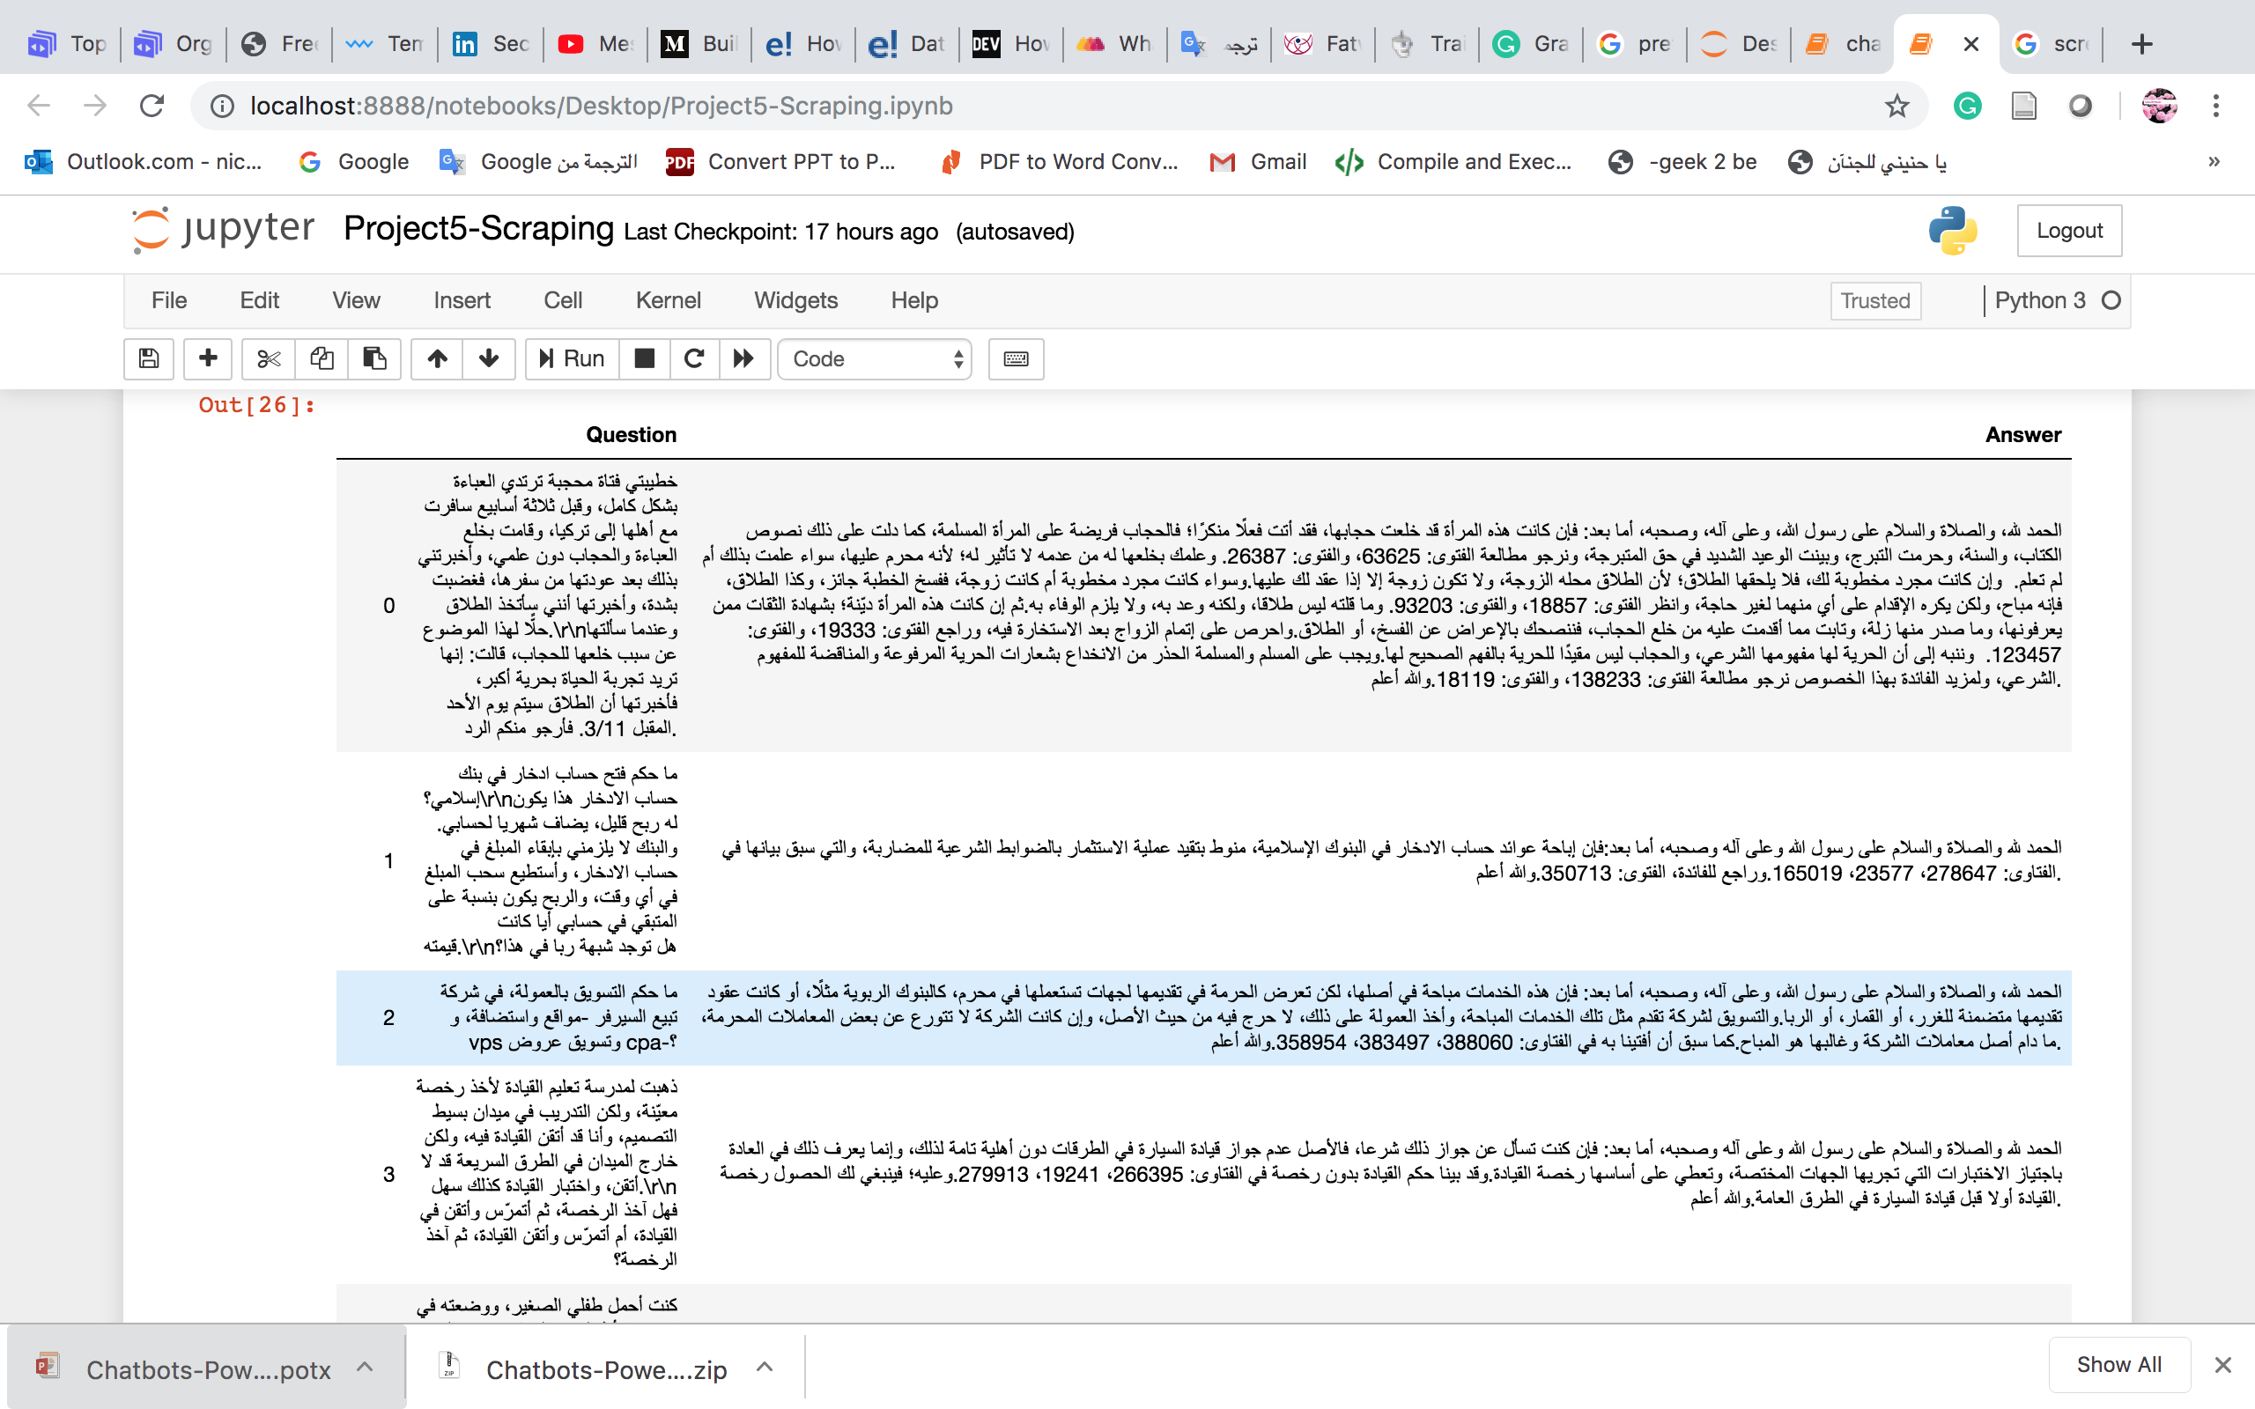
Fatwa Chatbot Collecting Dataset

Slide 10
Fatwa Chatbot Methodology Design
Collecting Dataset
Dataset Cleaning
Building Chatbot

Slide 11
Arabic Pre-Processing Steps
Remove special character
Remove punctuation
Remove stop words
Stemming

Slide 12
Fatwa Chatbot Methodology Design
Collecting Dataset
Dataset Cleaning
Building Chatbot

Slide 13
Building Chatbot
Chatterbot Library
Creating a new Arabic training class

Slide 14
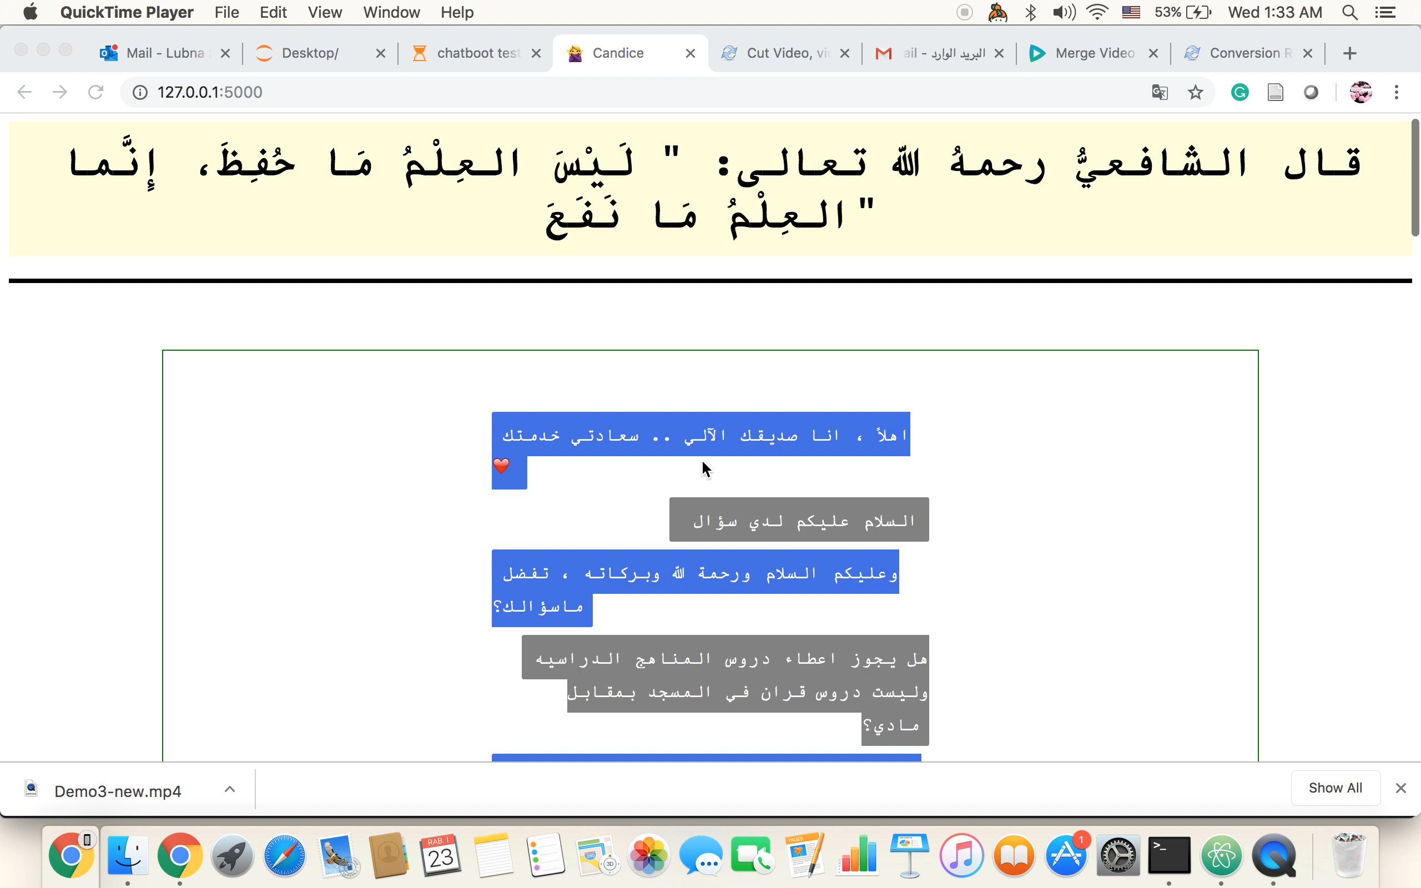
Demo

Slide 15
Conclusion and Future Work
Fatwa Chatbot was build to help people to answer their questions.
Islamweb.net was used to get Questions and answers.
For future work , pre-trained model such as AarVec and
deep learning will be used.
Collecting more fatwa from different source.

Slide 16
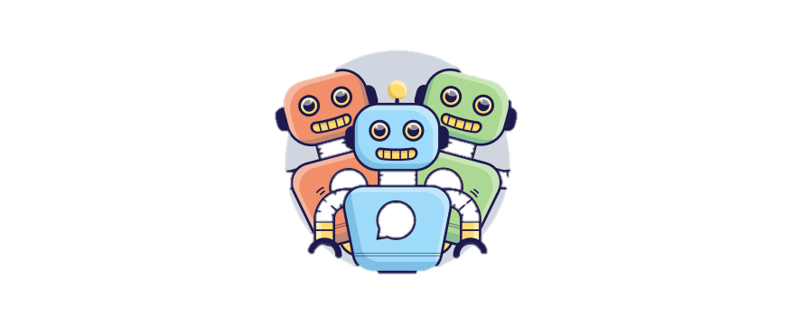
Thank You!

